Slide 1


Web Scraping and SQL Analysis of Top 100 U.S Companies by Revenue in 2024

Slide 2



To collect and analyze data on the 100 U.S companies by revenue for the year 2024.The data was sourced from a real-time website that ranks the companies based on revenue
Website link-https://en.wikipedia.org/wiki/List_of_largest_companies_in_the_United_States_by_revenue

Slide 3



Data Points Collected
Company Rank and Name
Industry
Revenue ( in USD millions)
Index
Revenue Growth
No of Employees and Headquarter Loactions

Slide 4

Tools and Techniques
Web Scraping
Data Storage
MySQL
Used Python library BeautifulSoup and Requests
The scraped data was stored in CSV file then imported to MySQL.
Data Preprocessing and Data Analysis is done by using MySQL.

Slide 5

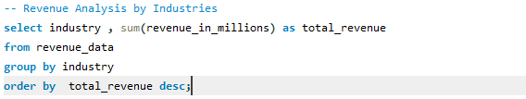


SQL Analysis
Revenue Analysis By Industry

Slide 6
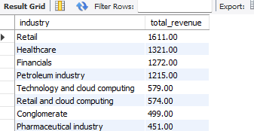
Retail , Healthcare and Finacials industries etc have the highest total revenue in U.S among all industries in 2024.

Slide 7
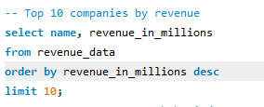
Top Companies by Revenue in U.S

Slide 8
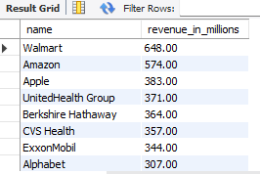
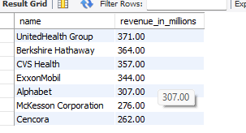
Walmart, Amazon and Apple are top 3 companies with the highest revenue in U.S by 2024.

Slide 9
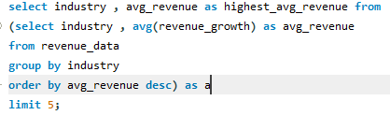
Average Revenue Growth of top 5 Industries

Slide 10
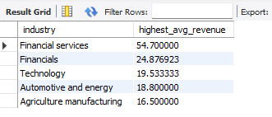
Financial Services industry has the highest avg revenue growth by 2024.

Slide 11
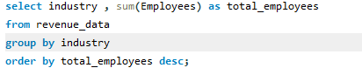
Employees Distribution by industries

Slide 12
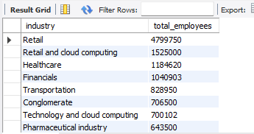
Retail dominates in terms of total employees, employing nearly 4.8 million people.
Retail and cloud computing, Healthcare, and Financials also have significant employee counts.
Technology and cloud computing sectors employ fewer people compared to the top industries like Retail.

Slide 13

Revenue per Employee

Slide 14

Fannie Mae, StoneX Group, and Valero Energy are the top three companies with the highest revenue per employee, indicating high operational efficiency.

Slide 15

Headquarters Analysis

Slide 16

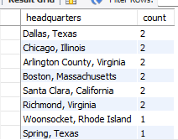

New York City stands as the premier business hub, housing the highest concentration of company headquarters, underscoring its significance as a global center for corporate leadership and economic activity

Slide 17
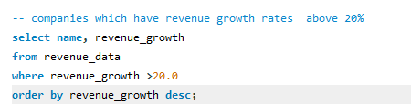
High Revenue Growth Companies

Slide 18
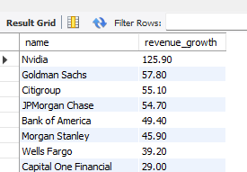
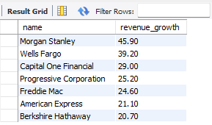
These are Companies in U.S which have High Revenue Growth Rate above 20% by 2024.

Slide 19

Minimum Revenue Growth Rate Companies

Slide 20
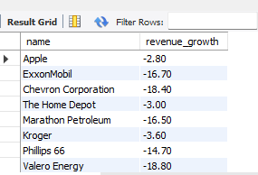
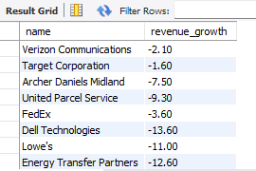
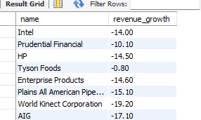
These are Companies in U.S which have lower Revenue Growth Rate below 0% by 2024.

Slide 21

Count of Companies which have lower Revenue Growth

Slide 22

These are total 36 Companies in U.S which have lower Revenue Growth Rate below 0% by 2024.

Slide 23
Insights
Total Revenue by Industry
Top 10 Companies
Avg Revenue Growth across different industries.
Examination of employees distribution and its correlation with revenue figures.
Recognition of Companies with significant revenue growth indicating market expansion
Examine Headquartes counts

Slide 24
Thank You

